Slide 1
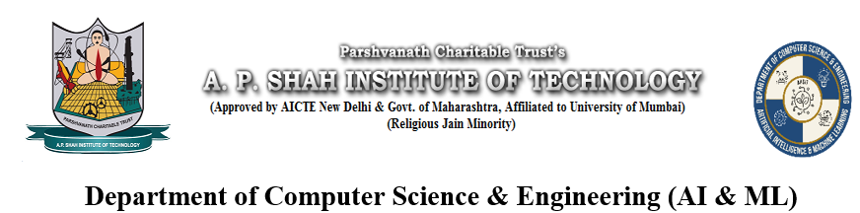
Job Recommendation and Resume
Parsing using NLP
Gaurav Dalvi (22106137)
Aryan Shailesh (22106123)
Eshwari Parab (22106066)
Project Guide
Prof. Darshana Bhamare
Notes:
1

Slide 2
Outline
Introduction
Literally Survey of Existing Systems
Limitations of the Existing Systems
Problem Statement
System Design
Technologies Stack for Proposed System
Goals Alignment
Implementation
Conclusion
References
Notes:
2

Slide 3
Introduction
This system helps users find the most suitable job opportunities based on their background and expertise.
It provides valuable insights into career options and industry trends.
The platform enhances user experience by making the job search process more efficient and interactive.
Motivation:
Observing that people should improve job matching accuracy based on skills ,we were inspired to create a unified solution for users.
Notes:
3

Slide 4
Goals Alignment
SDG 8 – Decent Work and Economic Growth
NLP-driven job recommendation systems help match job seekers with suitable roles more efficiently, reducing unemployment and underemployment.
SDG 4 – Quality Education
Resume parsing and job recommendation tools often highlight skill gaps, encouraging users to pursue upskilling or educational programs.
SDG 9 – Industry, Innovation, and Infrastructure
Utilizing advanced technologies like NLP and chatbots in HR systems supports innovation in employment services and infrastructure development.
Notes:
4

Slide 5
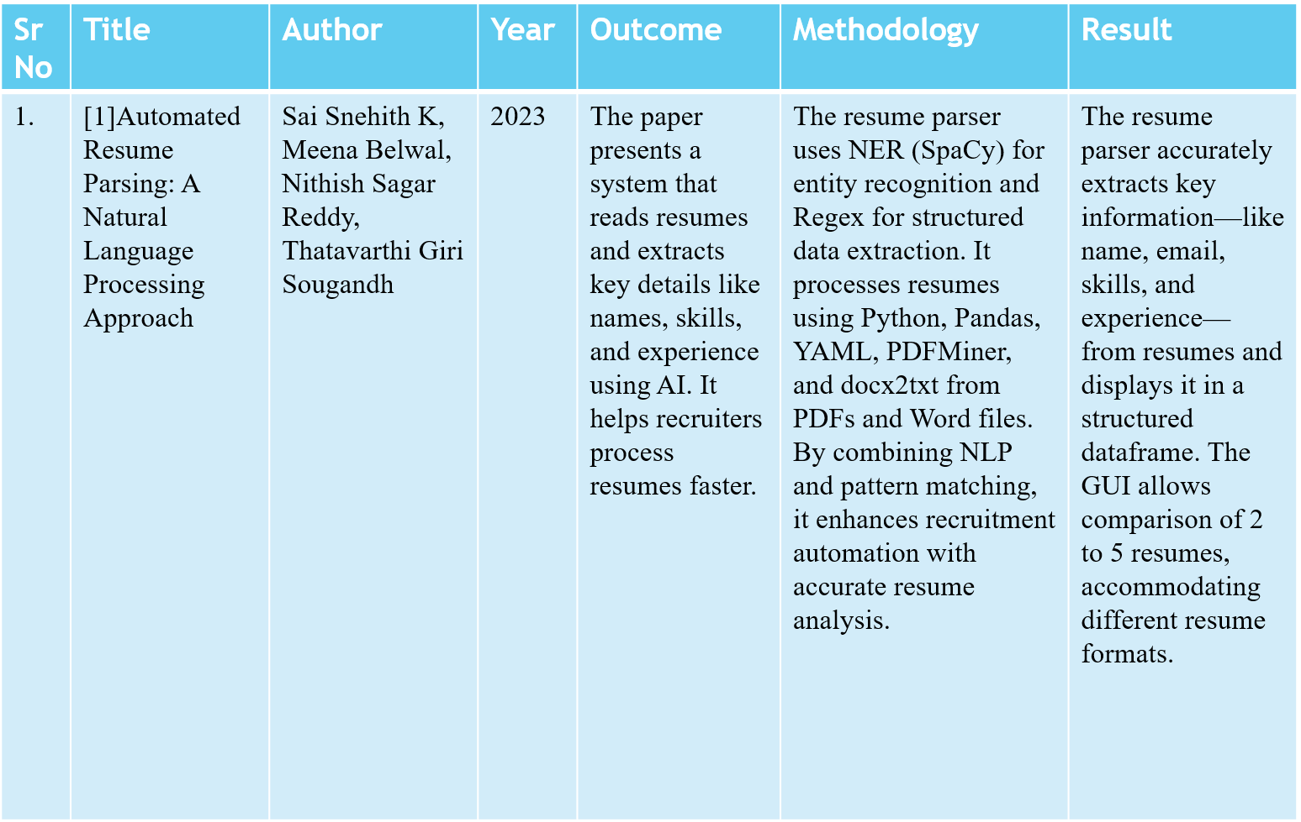
Literature Survey of the Existing System
Notes:
5

Slide 6
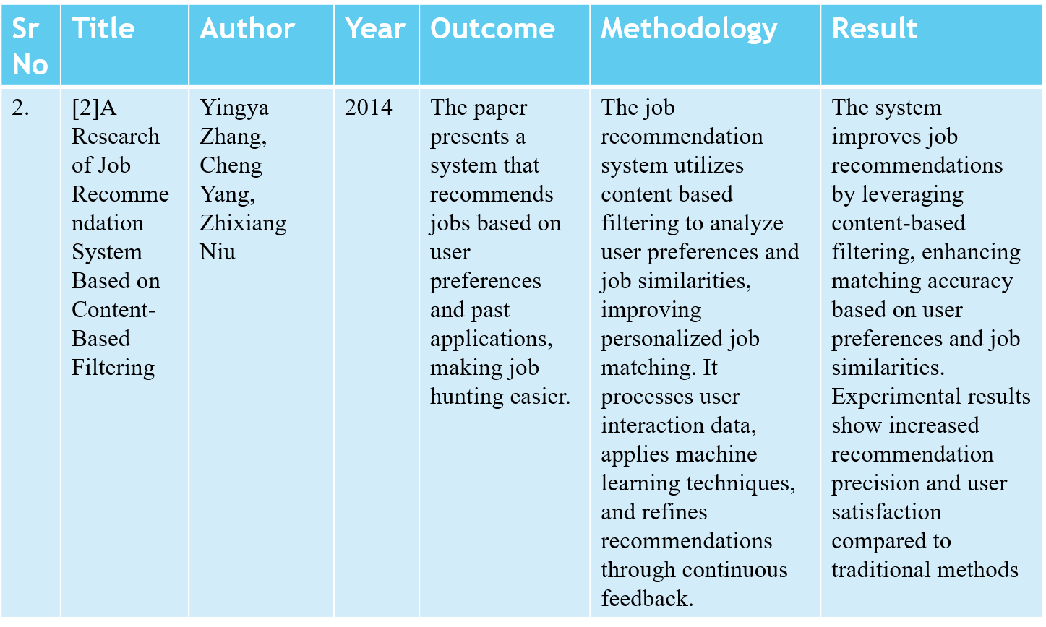
Literature Survey of the Existing System
Notes:
6

Slide 7
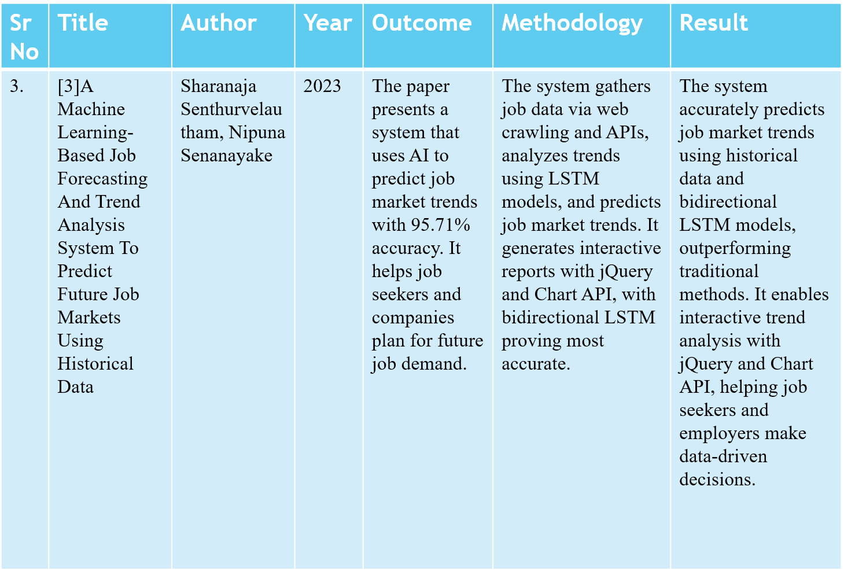
Literature Survey of the Existing System
Notes:
7

Slide 8
Limitations of Existing Systems
Lack of Personalization : Many Job recommender are often generic and do not consider individual preferences such as career growth, interests or company culture which is leading to irrelevant job recommendations.
Poor User Experience and Engagement : Complex user interfaces makes job searching inconvenient and confusing.
Limited Support for Career Growth: Most systems lack a chatbot-driven approach to guide users on upskilling courses or certifications that can enhance their job eligibility, focusing solely on skill assessment.
Ineffective Resume Parsing : Many job portals do not extract relevant details from resumes effectively i.e. skills and experiences listed in resumes may not be mapped correctly to job requirements.
Notes:
8

Slide 9
Problem statement
Users struggle to find relevant job opportunities because existing job portals rely on keyword-based matching rather than contextual NLP-driven recommendations.
Job seekers lack insights into their career progress, required skills, and job market trends due to inadequate data visualization and predictive analytics.
The absence of AI-driven chatbots leaves job seekers without personalized career guidance and real-time support.
Many existing platforms have complicated interfaces that make job searching and resume submission cumbersome.

Slide 10
Objectives
Help users to find relevant job opportunities using contextual NLP-driven recommendations.
Make it easier for job seekers check insights into their career progress and job market trends with the help of data visualization and predictive analytics.
Provide an AI-driven chatbot to help with personalized career guidance and real-time support.
Build an interactive and easy to navigate user interface for job seekers.

Slide 11
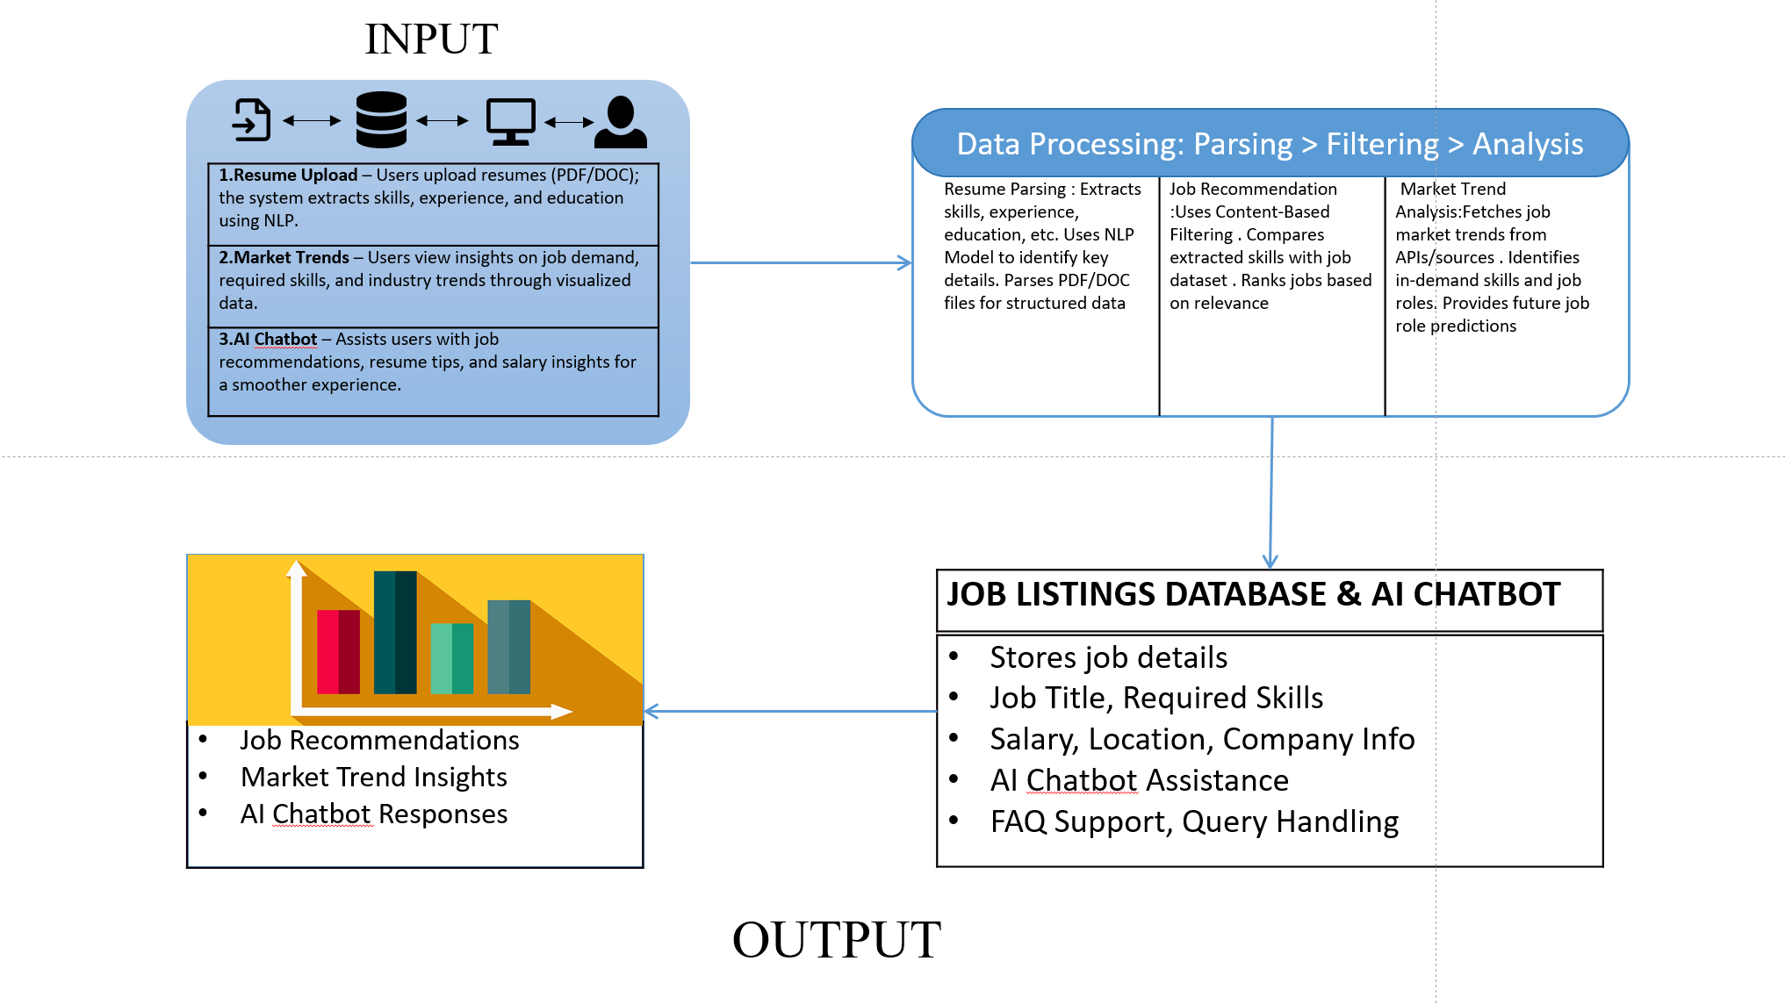








System Design
FAQ Support, Query Handling
FAQ Support, Query Handling

Slide 12
Technology Stack for Proposed System
Front-End
HTML5
CSS
JAVASCRIPT
Back-End
Flask: Python Framework
Database
SQL
Algorithm
Natural Language Processing
Content-Based Filtering
Notes:
12

Slide 13
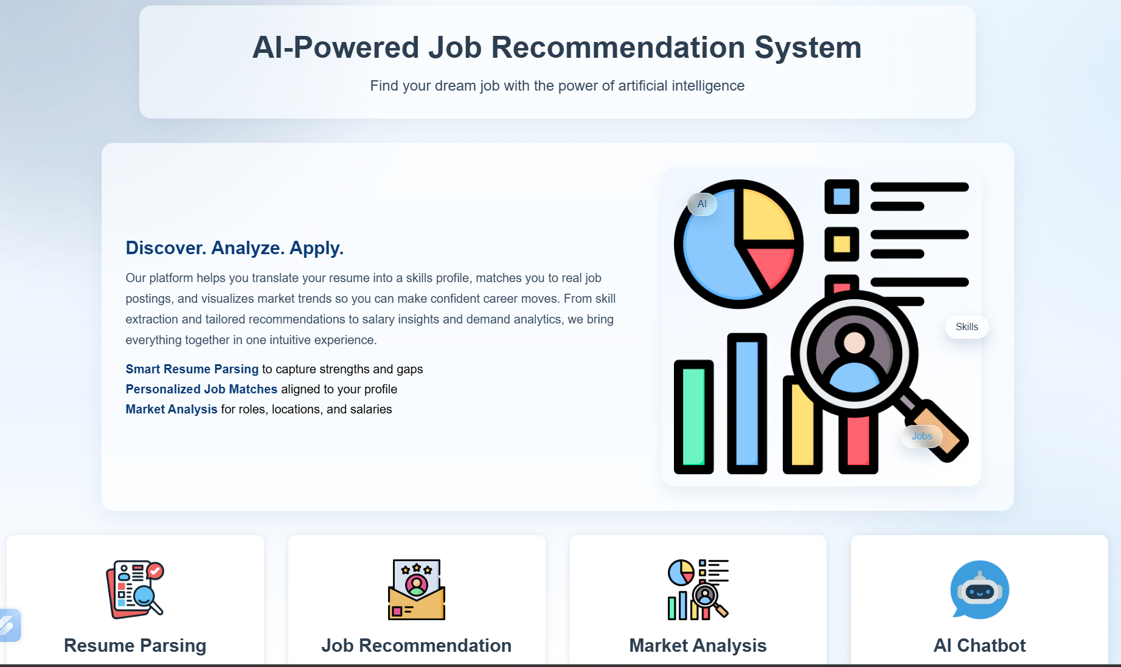
Implementation
Notes:
13

Slide 14
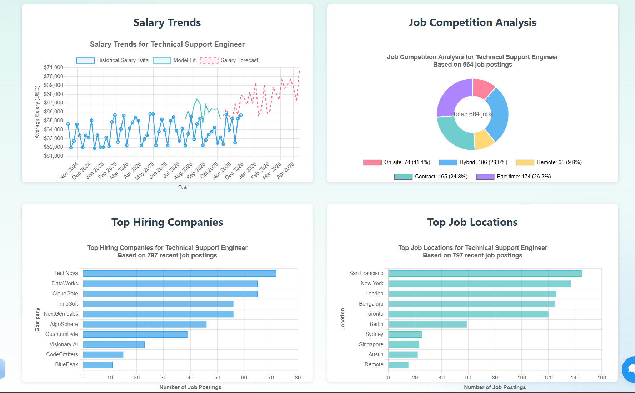
Implementation
Notes:
14

Slide 15
Conclusion
Hence, Development and Implementation of 50% of Web based platform providing seamless user experience.
Job Recommendation and Resume Parsing System is providing a comprehensive platform for user, through its user-friendly interface.
Notes:
15

Slide 16
References
[1] Automated Resume Parsing: A Natural Language Processing Approach,7th International Conference on Computation System and Information Technology for Sustainable Solutions, Zhejiang University,2023
[2]A Research of Job Recommendation System Based on Content-Based Filtering, 7th International Symposium on Computational Intelligence and Design , Zhejiang University,2014.
[3]A Machine Learning-Based Job Forecasting And Trend Analysis System To Predict Future Job Markets Using Historical Data, 8th International Conference for Convergence in Technology Pune, India,2023
Notes:
16

Slide 17
Thank You...!!
Notes:
17

